Slide 1
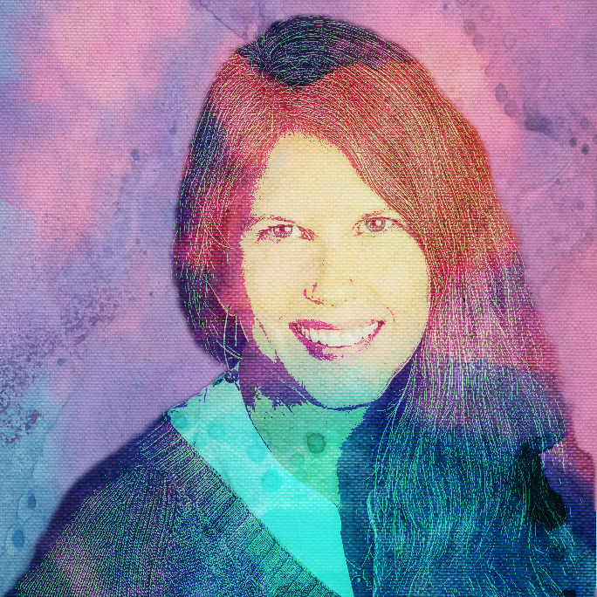
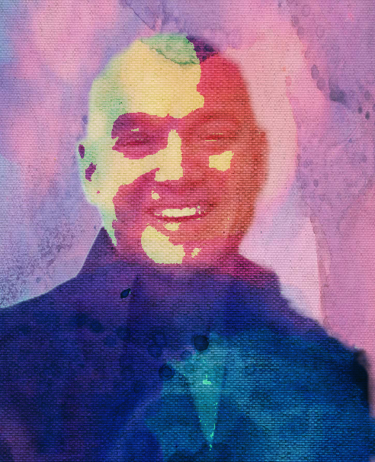
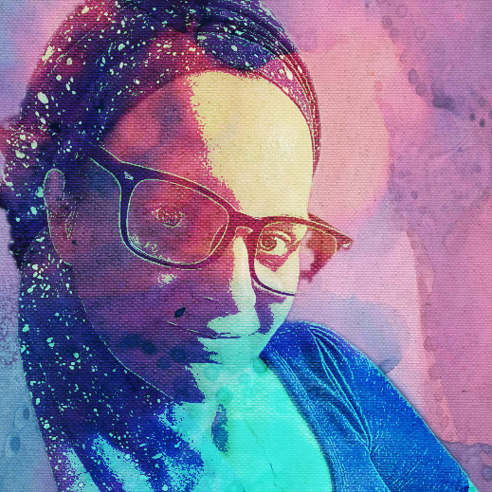
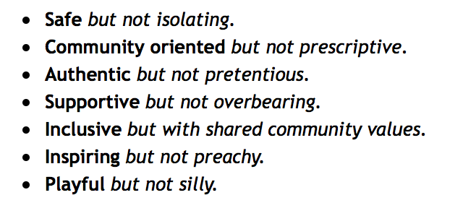
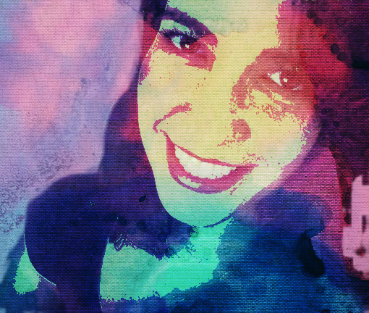
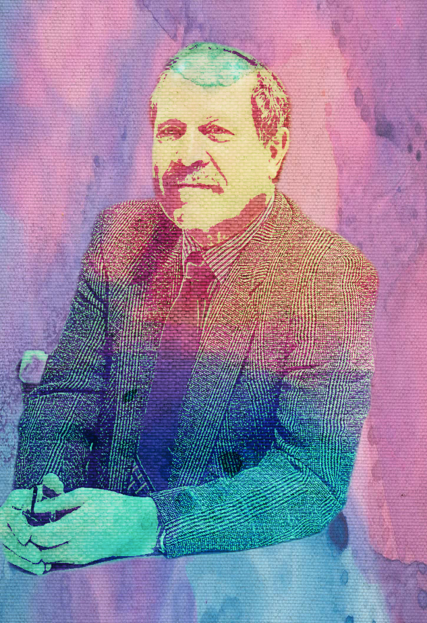
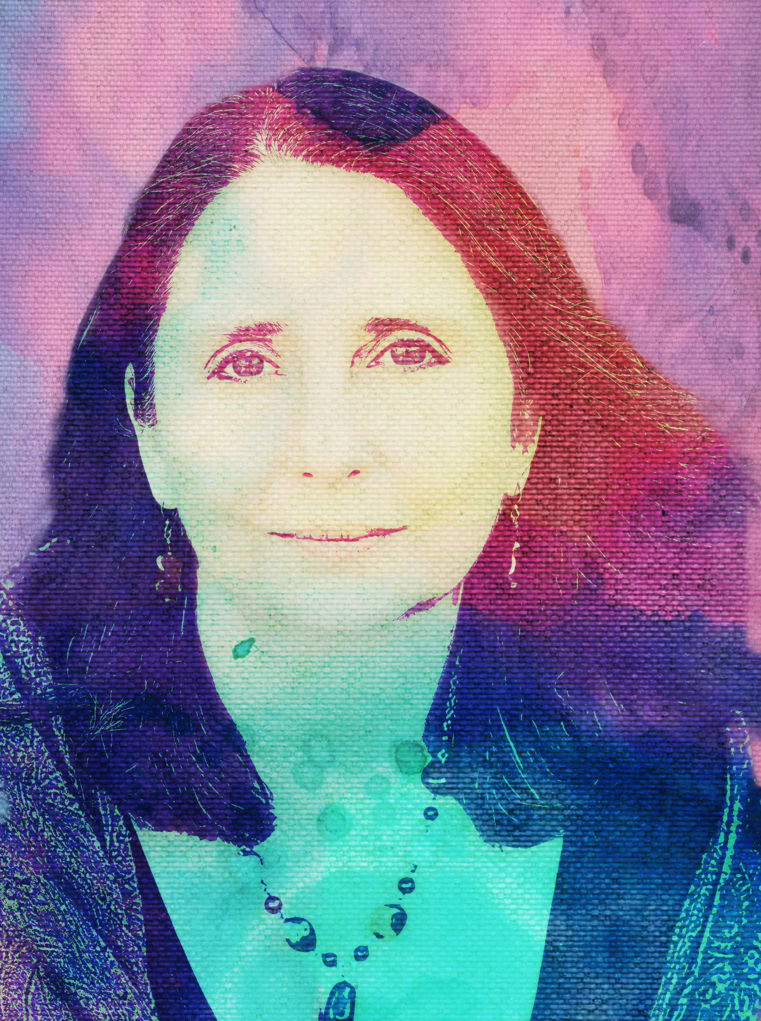
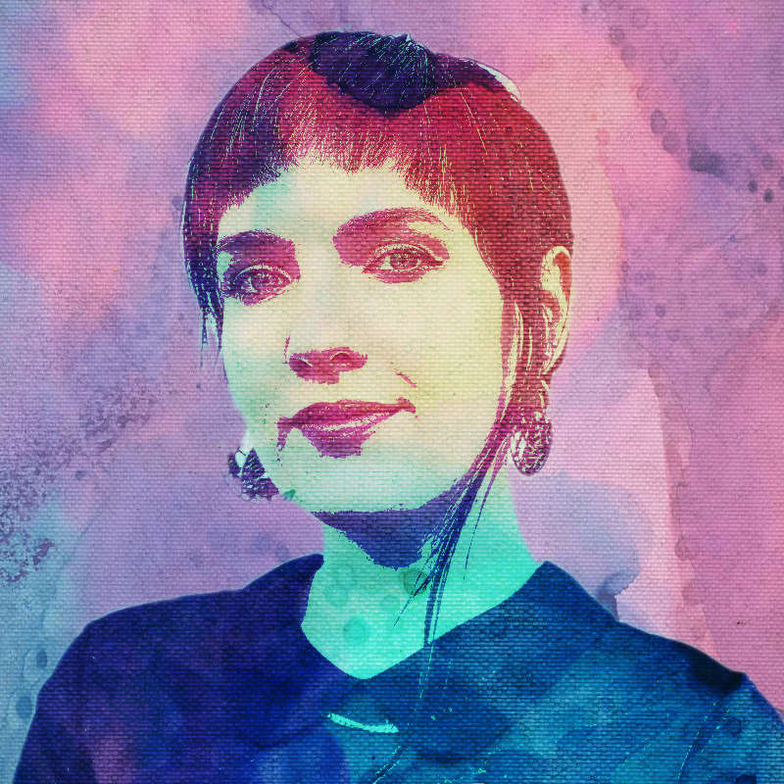
TILC’s core & comms team
Elisa Guyton
Community Engagement Director
Evangelist & community engager
“The Butterfly”
ElisaG@the-ilc.org
Callan Loo
Founder & Executive Director
Visionary & builder
“The Visionary”
CallanL@the-ilc.org
Kellyn Jean
Social Media Manager
Connector
“The Connector”
KellynJ@the-ilc.org
We are …
Leah Myers
Creative/CEC Director
Visual arts wizard
“The Artist”
LeahM@the-ilc.org
Neil Simon
Board Member
Executive coach
“The Coach”
NeilS@the-ilc.org
Mara Evenstar
Conscious Rites Director
Ritualist and creatrix
“The Priestess”
MaraE@the-ilc.org
Mandy Brownholtz
Acting Marketing Manager
Branding & mktg strategist
“The Strategist”
MandyB@the-ilc.org

